Slide 1

Modern Universal Library Explorer
How MULE will jumpstart your library’s efficiency with simple, clean implementation

Slide 2
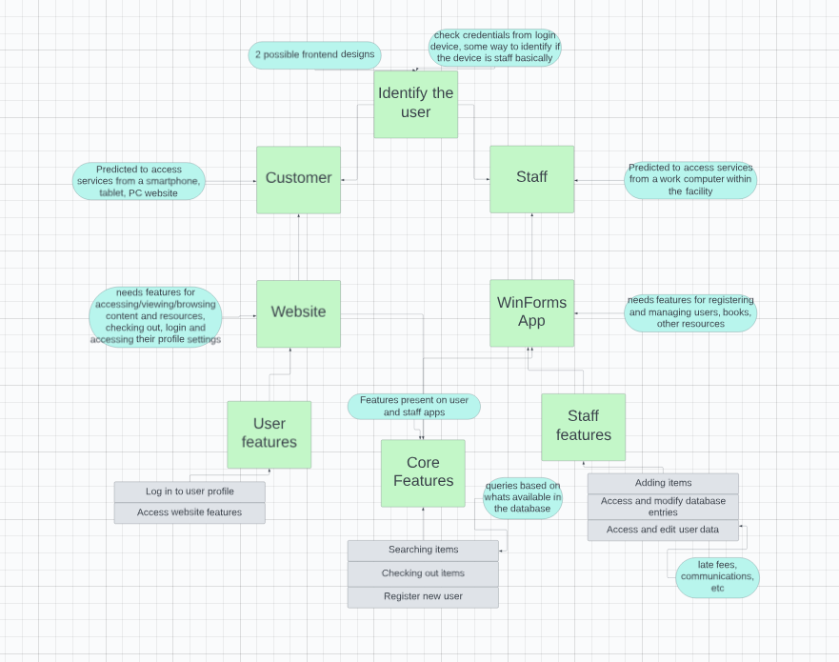
GUI Tailor-made for accessibility

Slide 3
Coded internally in C# and designed for airtight, lossless integration between application UI and database
The number one priority of our program’s logic is to ensure no data is lost between operator use and database knowledge, ensuring the database is always guaranteed to be up to date and the UI presenting accurate information without fail.
This focus on security and simplicity means no important university documents, books or hardware will ever be lost to application errors or issues, and you’ll always know where a book is, whether with a student or on the shelves.

Slide 4
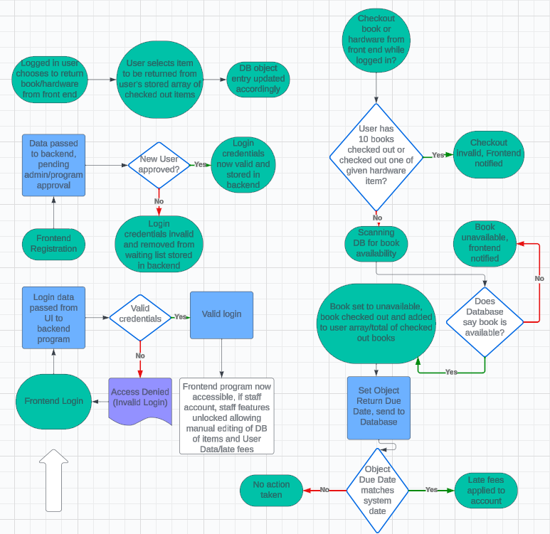
Backend function visualized
With around only 25 possible interactions, the program is kept simple and uncomplicated, going along with our focus on functional and bugless design

Slide 5
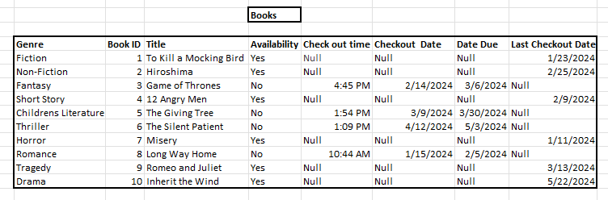
Our Database Design
The library database is the system where we store all the books and computers for people to check out. This database allows the staff to see what is available and what isn’t. It has 2 tables, one for the books and one for the computers. The book table is categorized by genre, such as fiction, non fiction, fantasy etcetera and all the book titles will be under one of these genres. The books also have an id as a way of keeping track of it. There is also an availability column that is either marked yes or no. When someone checks out a book it will keep track of what time and what day it was checked out on and they will have 3 weeks to return it before it’s due. Once they return it will mark that date on the table under the last checkout date column.

Slide 6
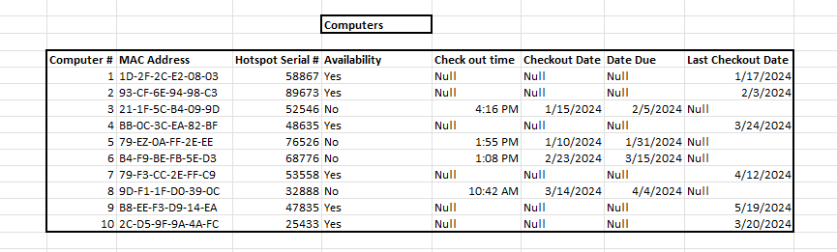
Tech Database
The second table is where we keep track of the computers. Like the book table, the computer table has a column for checkout time, checkout date, and date due. That’s how it will determine if the computer is available. Each computer is numbered and tracked with a MAC address to figure out what network they're on. For each computer there is also an option for a hotspot which is tracked by a serial number.

Slide 7
Q&A – Open Floor
FAQ
Why are you so good at programming, MULE team?
Can we donate money to you?

